Slide 1

Hospital management System

Slide 2
About
A Hospital Management System (HMS) is a software application designed to streamline and automate various functions and operations within a hospital or healthcare facility. Its primary purpose is to manage all aspects of hospital activities, including patient care, administrative processes, and financial operations. The system facilitates the smooth functioning of the hospital by integrating various departments, reducing human error, enhancing communication, and improving overall efficiency.

Slide 3
Objectives
Main objectives of a Hospital Management System are:
Design a system for better patient care.
Reduce hospital operating costs.
Provide MIS (Management Information System) report on demand to management for better decision making.
Better co-ordination among the different departments.
Provide top management a single point of control.

Slide 4
Existing System
Lack of security of data
Time consuming.
Consumes large volume of paper work.
Manual work.
No direct role for the higher officials.

Slide 5
New System
Digitize appointment booking with patient portals.
Track the availability of medical stocks.
Furnish and validate insurance details.
Keep track of the complete vaccination program .
Patient call the ambulance then ambulance track patient phone number through location of a patient.

Slide 6
Admin and Security
User Roles and Permissions: Define roles (Admin, Doctor, Nurse, Patient, etc.) with access control to different sections.
Audit Trail: Keep logs of all activities for security and compliance.
Data Encryption and Privacy: Ensure data privacy, especially for sensitive patient information.

Slide 7
Technology Stack:
Frontend:
HTML, CSS, JavaScript: For designing the user interface.
Backend:
Java
Database:
JDBC
Mysql
Server:
Tomcat server.
Code editor:
ExlipseId

Slide 8
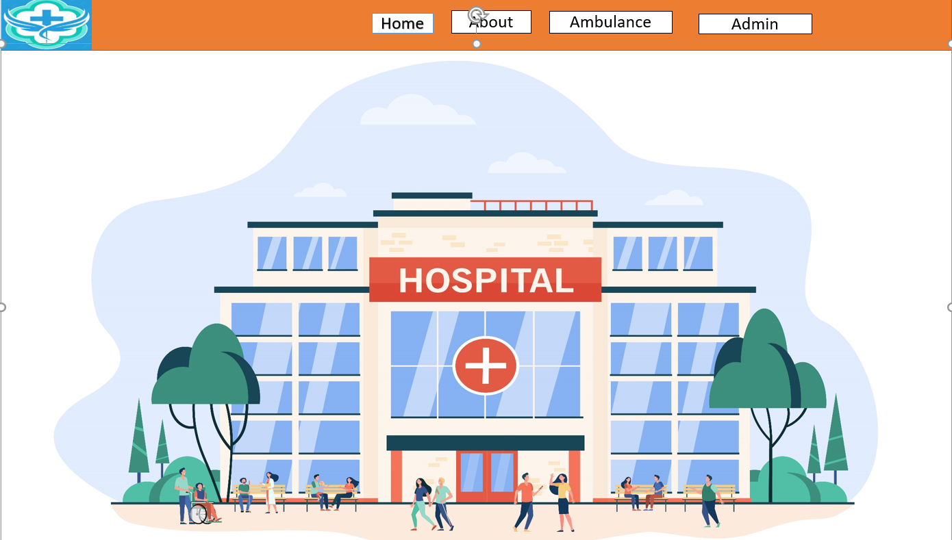
Design

